Slide 1

The Time is Now to Fix the Evidence Generation System
Robert M Califf, M.D.
Commissioner of Food and Drugs
Society for Clinical Trials
43rd Annual Meeting
May 17, 2022

Slide 2
The Opportunity
Biomedical science and technology are in an amazing period of discovery and development.
Yet these advantages are not resulting in superior health and outcomes for the U.S. population or for most individuals.
The intersection of biomedical science, technology and communication, if handled with good policies, investment and communication, could usher in a new era of better health for the U.S. and the world.
Previous policies and infrastructure investment provide a solid base from which to build an effective system for evaluation and implementation across the spectrum of development, pivotal trials and post-market evaluation.

Slide 3
Evidence Generation & FDA 2022
FDA mission and priorities.
Why do we need to improve the evidence generation system?
What have we learned about evidence generation in the pandemic?
Hopes for the future.

Slide 4
The FDA: Big Picture
Regulatory Agency
Science Agency
Public Health Agency
Multiple disciplines always in play
  Science/Medicine/Public Health
  Policy
  Law

Slide 5


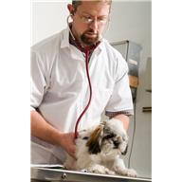


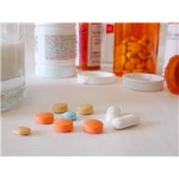

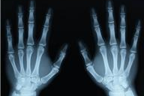
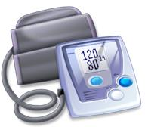
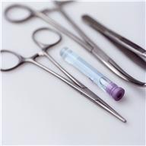
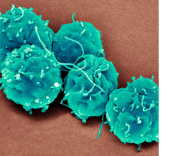



FDA Regulates a Spectrum of Health Products :
20-25 cents of every GDP dollar

Slide 6
FDA Mission
FDA is responsible for protecting the public health by assuring the safety, efficacy and security of human and veterinary drugs, biological products, medical devices, our nation’s food supply, cosmetics, and products that emit radiation.
https://www.fda.gov/about-fda/what-we-do

Slide 7
FDA Mission
FDA is also responsible for advancing the public health by helping to speed innovations that make medical products more effective, safer, and more affordable and by helping the public get the accurate, science-based information they need to use medical products and foods to maintain and improve their health.
https://www.fda.gov/about-fda/what-we-do

Slide 8
FDA Mission
FDA also has responsibility for regulating the manufacturing, marketing, and distribution of tobacco products to protect the public health and to reduce tobacco use by minors.
https://www.fda.gov/about-fda/what-we-do

Slide 9
FDA Mission
Finally, FDA plays a significant role in the Nation’s counterterrorism capability. FDA fulfills this responsibility by ensuring the security of the food supply and by fostering development of medical products to respond to deliberate and naturally emerging public health threats.
https://www.fda.gov/about-fda/what-we-do

Slide 10
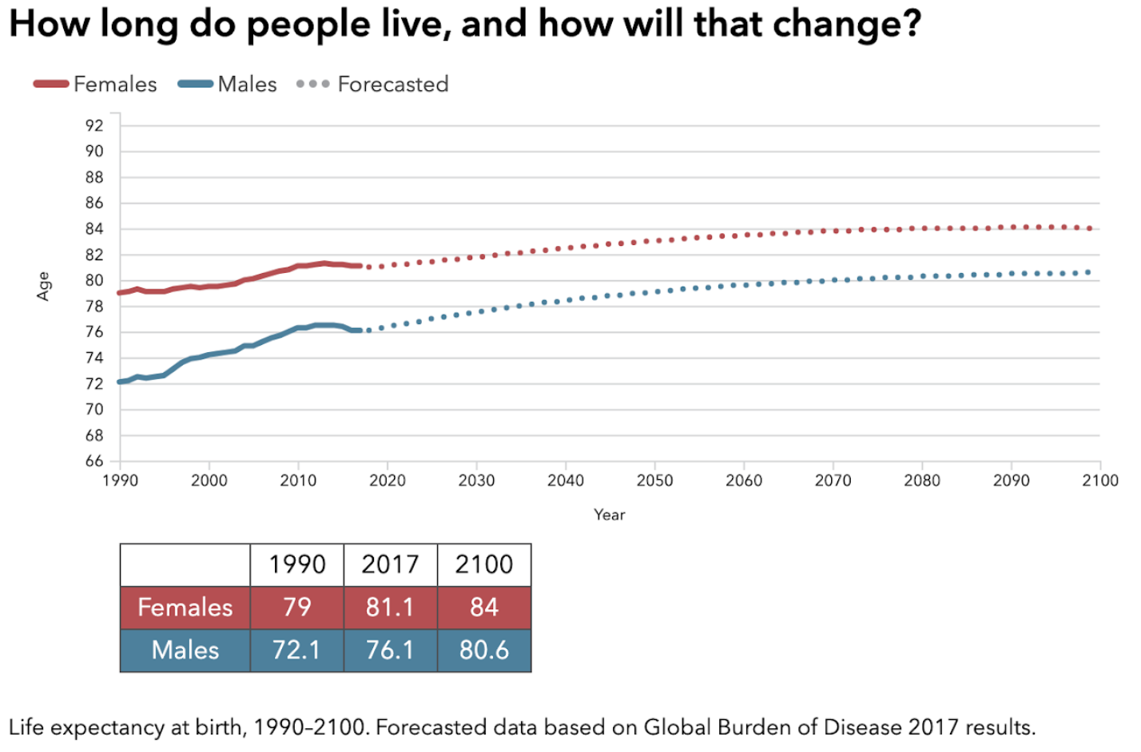

Slide 11
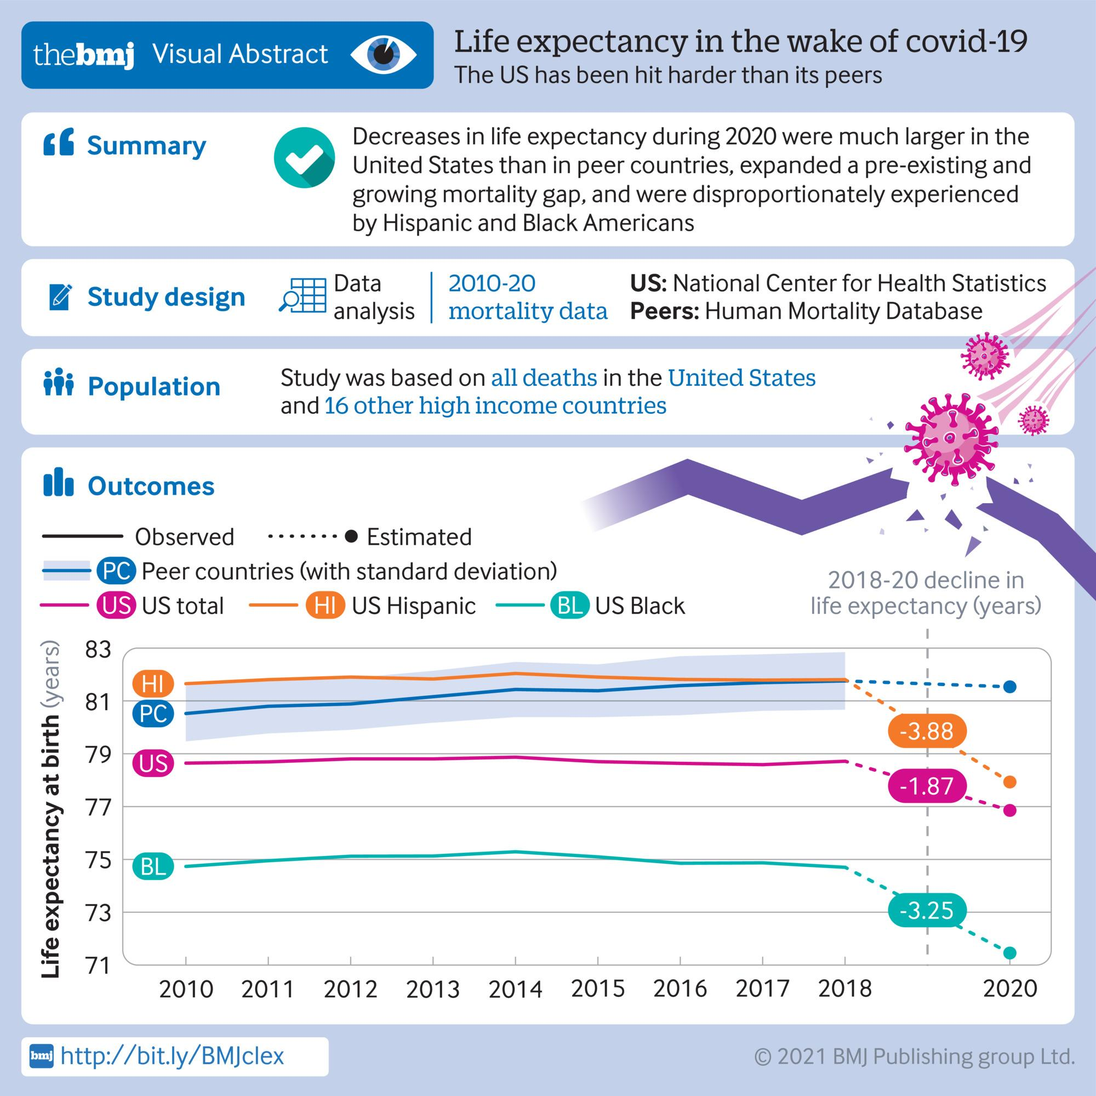

Slide 12
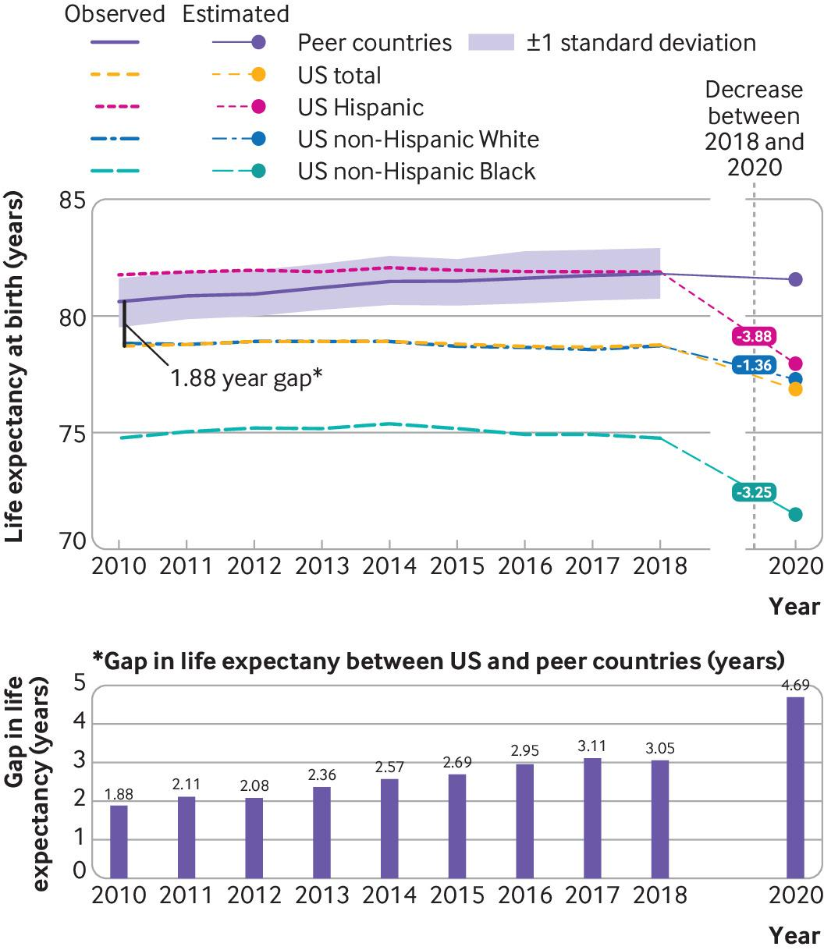
Life expectancy at birth in the United States, by race and ethnicity,
and in peer countries for years 2010-18 and 2020.

Slide 13
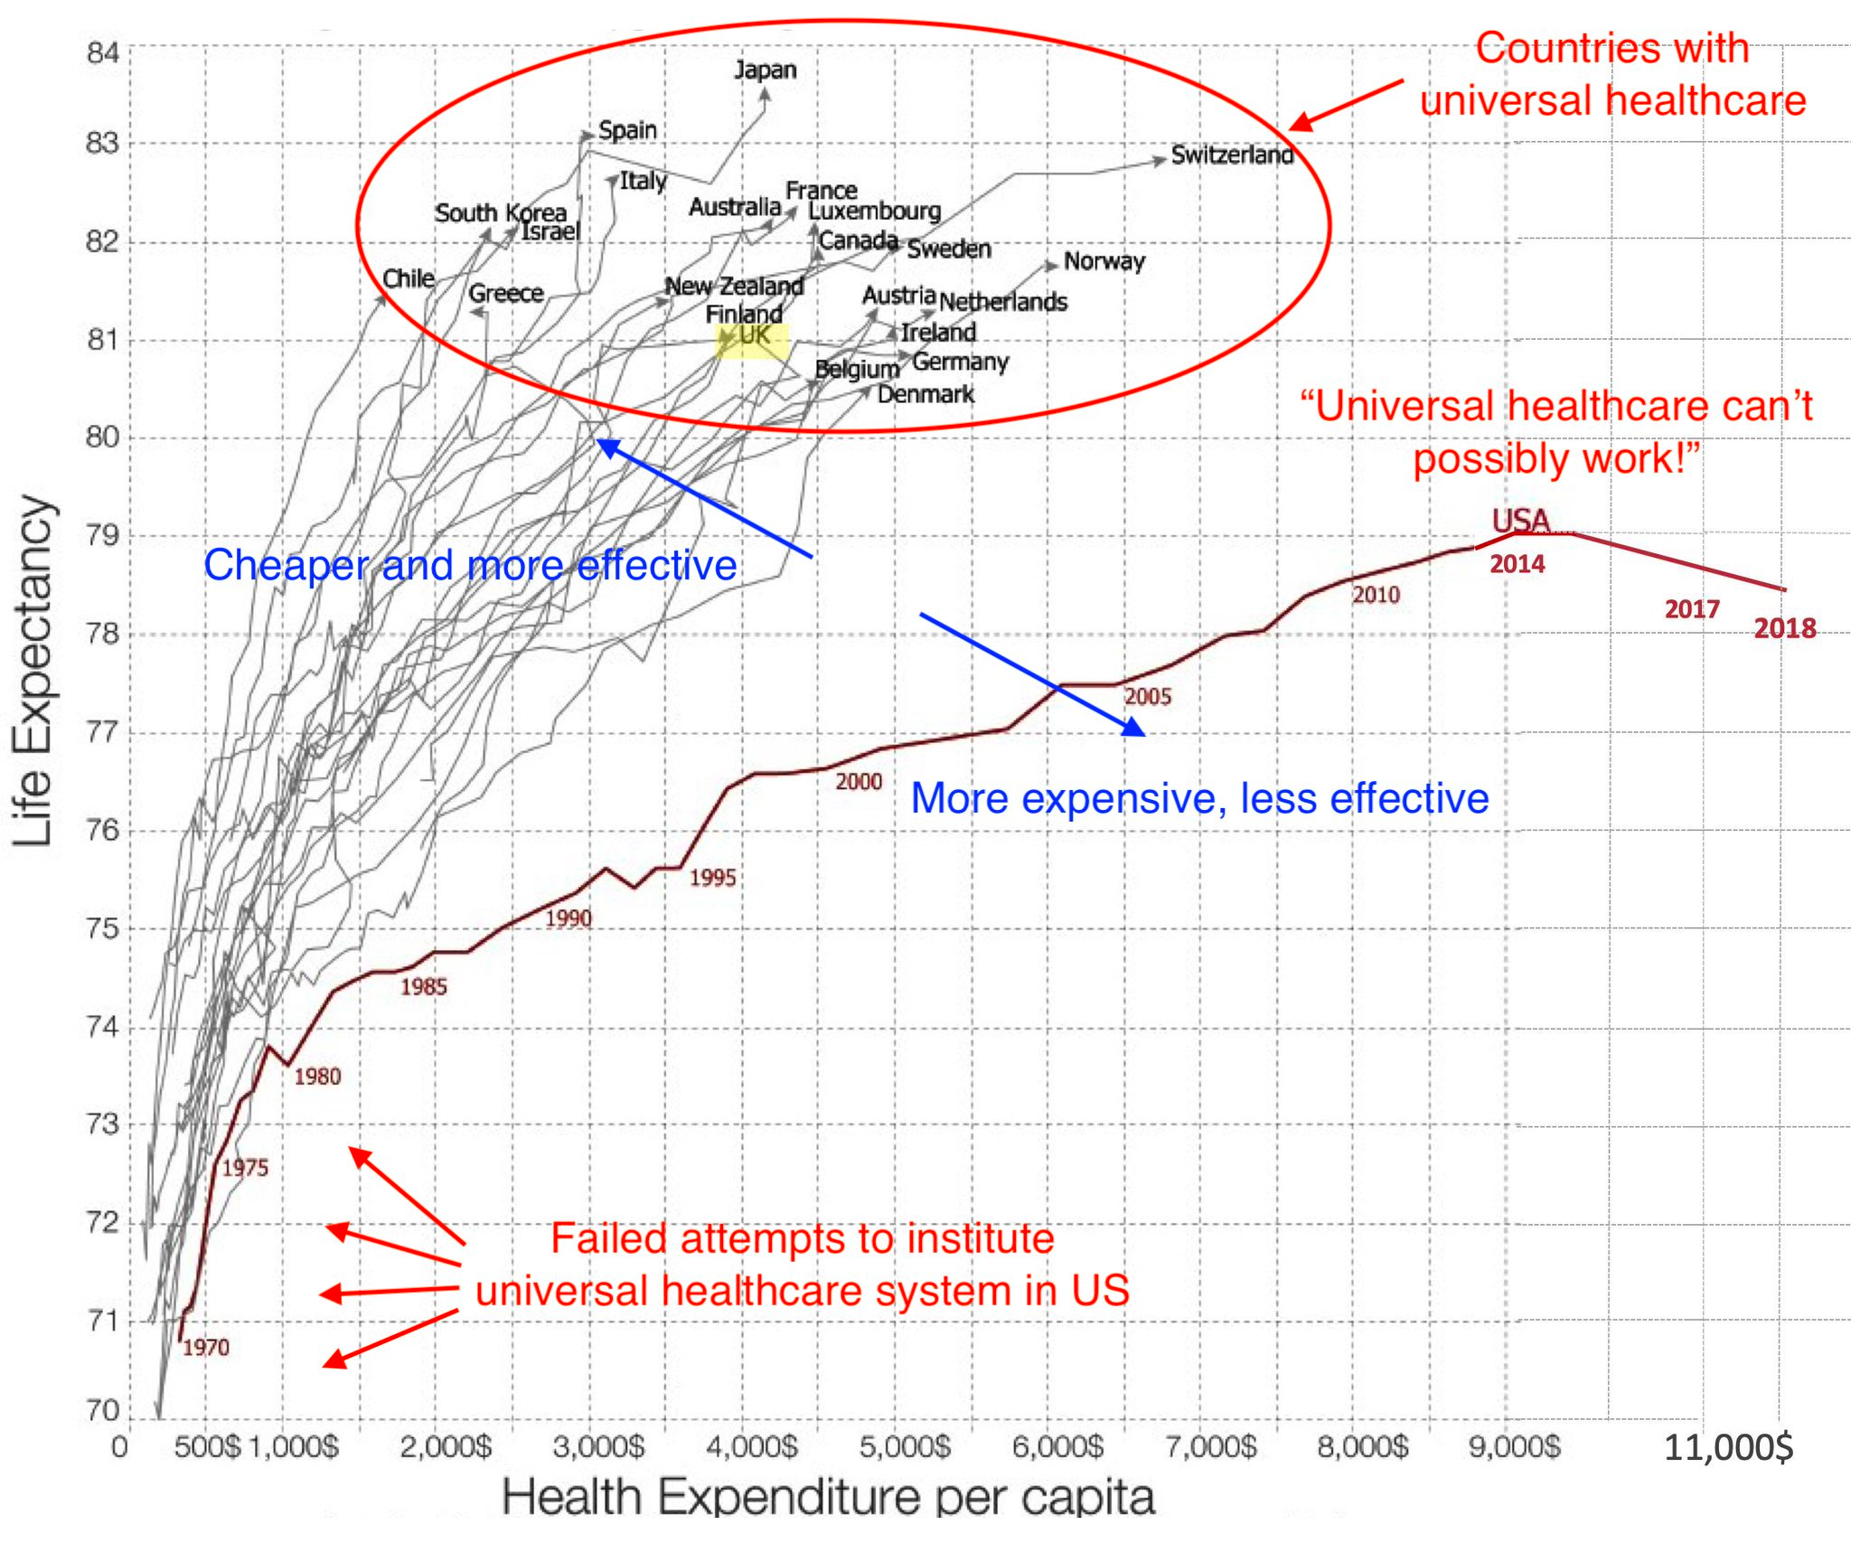

Slide 14
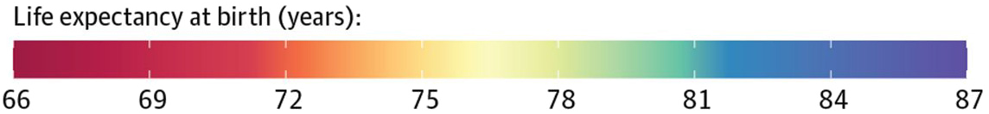
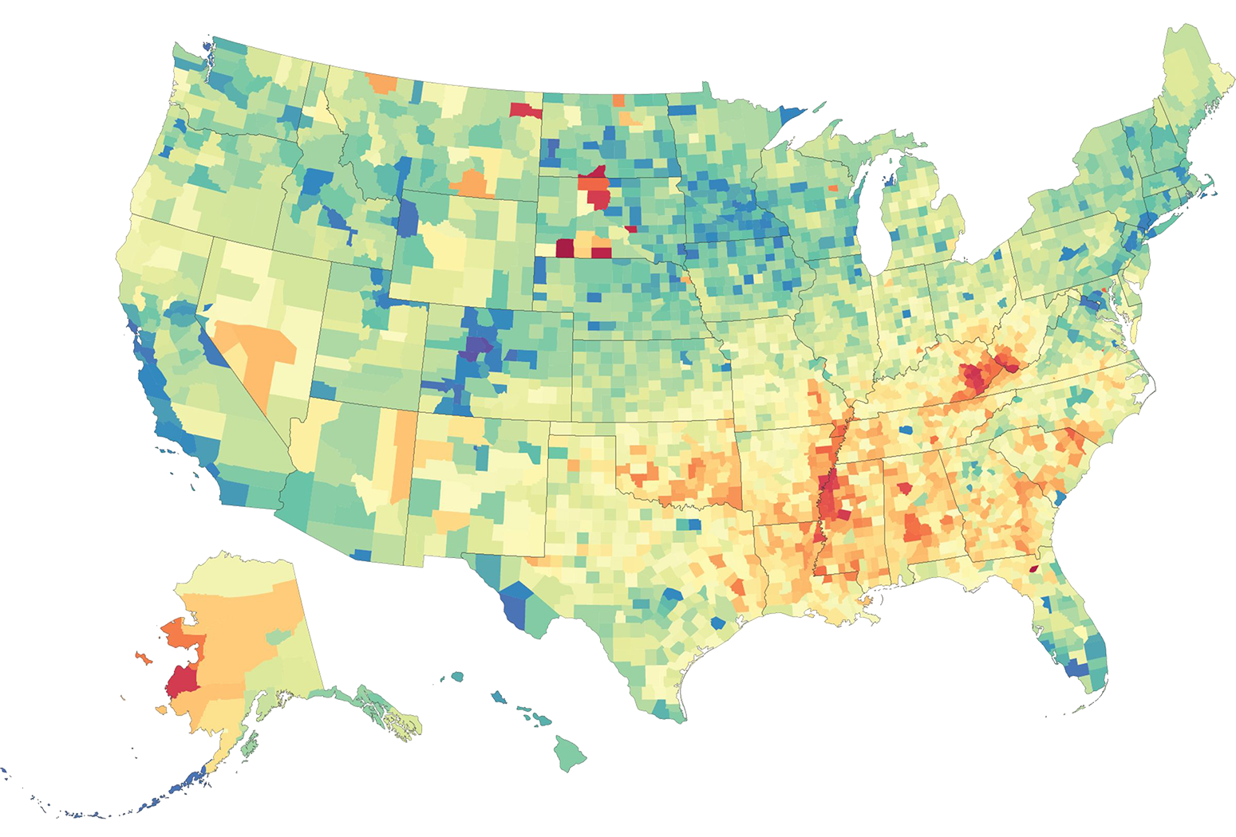
Life Expectancy at Birth by County, 2014
Counties in South Dakota and North Dakota had the lowest life expectancy, and counties along the lower half of the Mississippi, in eastern Kentucky, and southwestern West Virginia also had very low life expectancy compared with the rest of the country
Counties in central Colorado had the highest life expectancies
Source: Dwyer-Lindgren L, et al. Inequalities in life expectancy among US counties, 1980 to 2014 - temporal trends and key drivers.
JAMA Intern Med. 2017;177:1003-11. doi:10.1001/jamainternmed.2017.0918

Slide 15
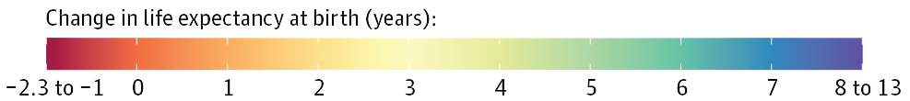
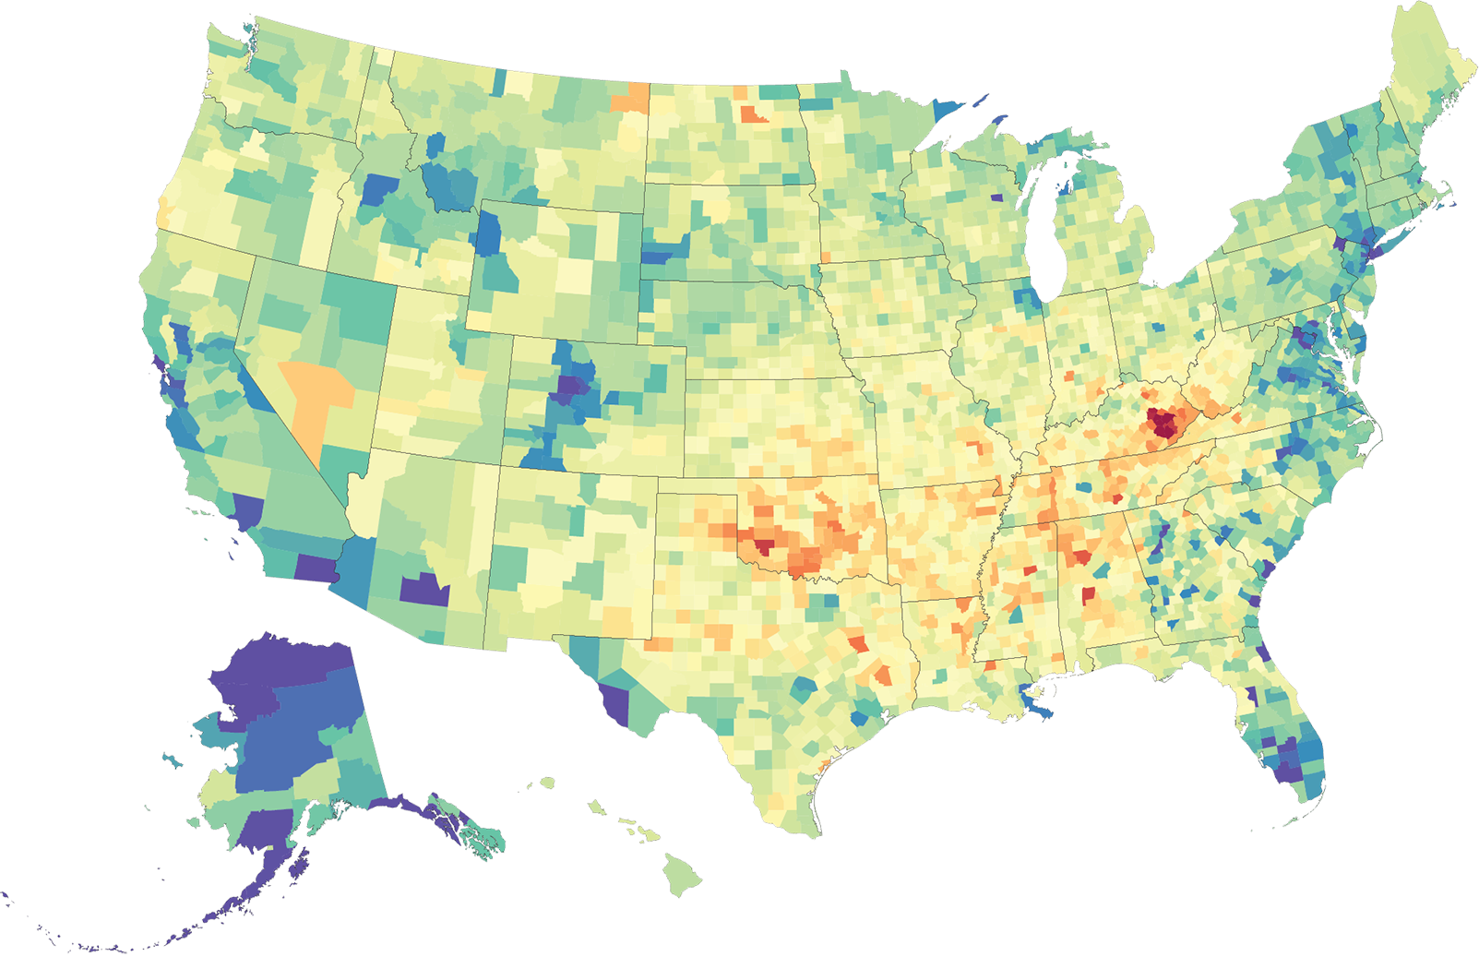
Change in Life Expectancy at Birth by County,
1980 to 2014
Compared with the national average, counties in central Colorado, Alaska, and along both coasts experienced larger increases in life expectancy between 1980 and 2014, while some southern counties in states stretching from Oklahoma to West Virginia saw little, if any, improvement over this same period
Source: Dwyer-Lindgren L, et al. Inequalities in life expectancy among US counties, 1980 to 2014 - temporal trends and key drivers.
JAMA Intern Med. 2017;177:1003-11. doi:10.1001/jamainternmed.2017.0918

Slide 16
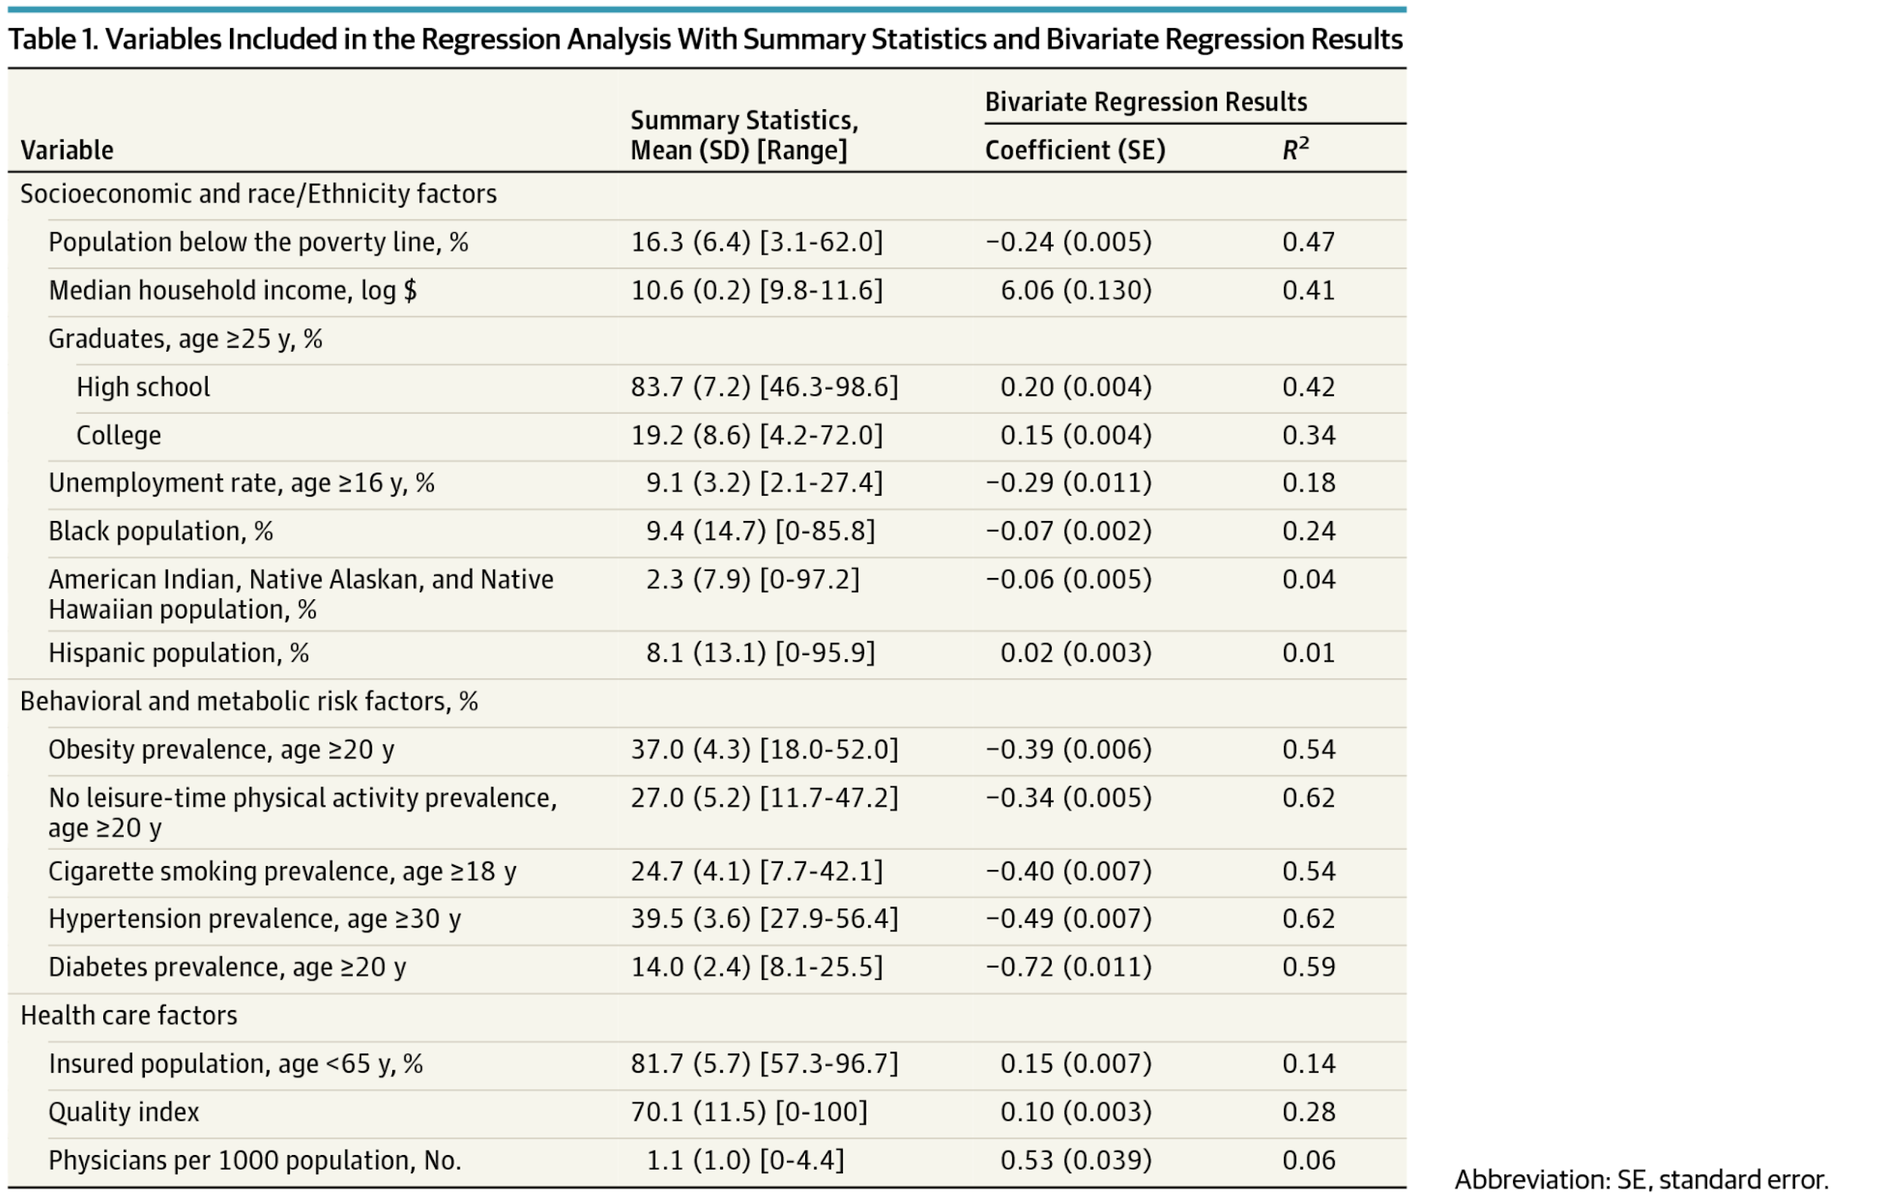
From: Inequalities in Life Expectancy Among US Counties, 1980 to 2014 Temporal Trends and Key Drivers
JAMA Intern Med. Published online May 08, 2017. doi:10.1001/jamainternmed.2017.0918
Source: American Medical Association.2017.
Table Title:
Variables Included in the Regression Analysis With Summary Statistics and Bivariate Regression Results

Slide 17
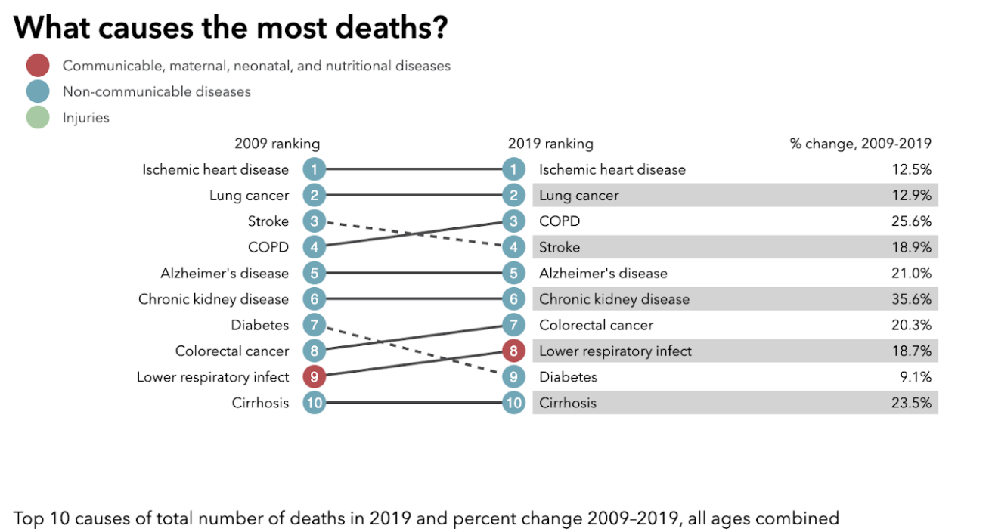

Slide 18
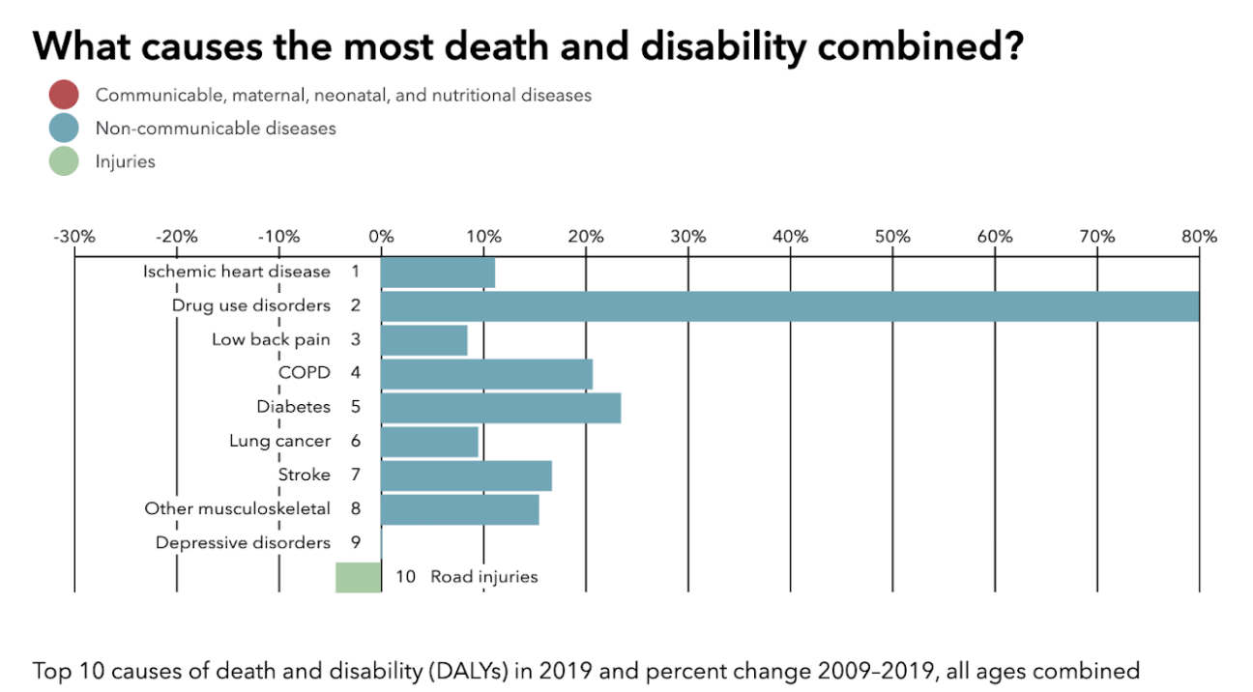

Slide 19
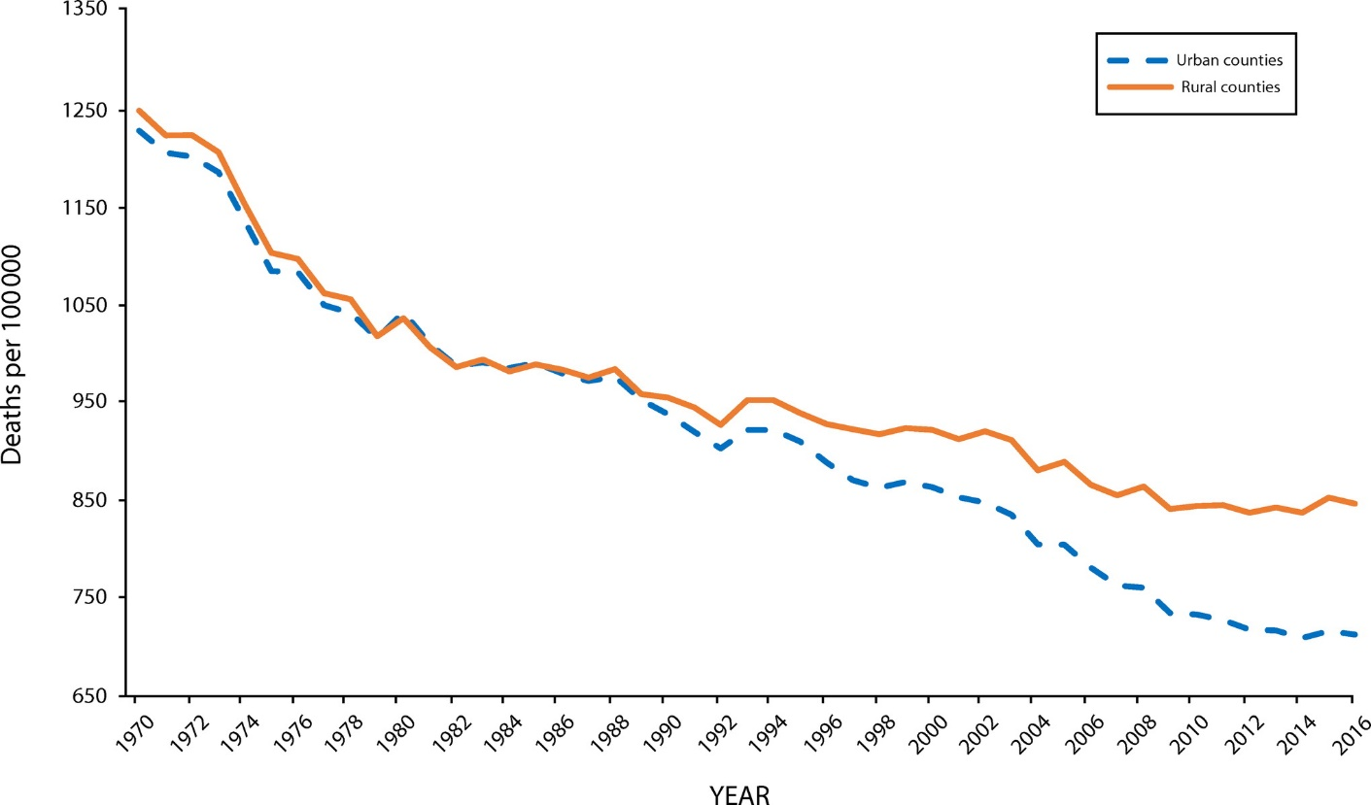
Mortality in Rural America
In Mid ‘80s: Rural and urban death rates were approximately equal
2016: 134.7 excess deaths/100,000 in rural - a nearly 20% disparity
Life expectancy is approximately 3 years lower
Higher stroke and CV mortality
Higher maternal mortality (much of which is cardiovascular)

Slide 20
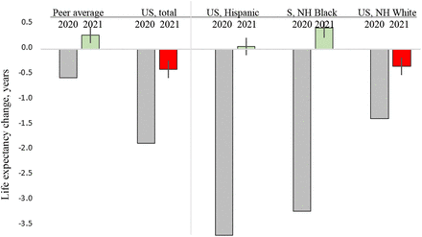
The Impact of the Pandemic on US Life Expectancy has not been Uniform
Source: medRxiv preprint DOI: https://doi.org/10.1101/2022.04.05.22273393

Slide 21
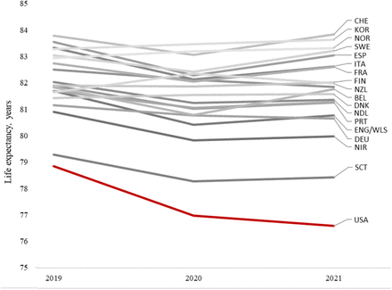
U.S. Continues to Lose Ground in Life Expectancy
Source: medRxiv preprint DOI: https://doi.org/10.1101/2022.04.05.22273393

Slide 22

DRUG DISCOVERY AND DEVELOPMENT TIMELINE
Drug Discovery
Preclinical
Clinical Trials
FDA Review
Scale-Up to Mfg.
Post-Marketing Surveillance
~ 5,000 – 10,000 COMPOUNDS
250
5
One FDA-
Approved
Drug
Pre-Discovery
PHASE 1
PHASE 2
PHASE 3
IND SUBMITTED
NDA SUBMITTED
NUMBER OF VOLUNTEERS
20-100
100-500
1,000-5,000
3 – 6 YEARS
6 – 7 YEARS
0.5 – 2 YEARS
INDEFINITE

Slide 23
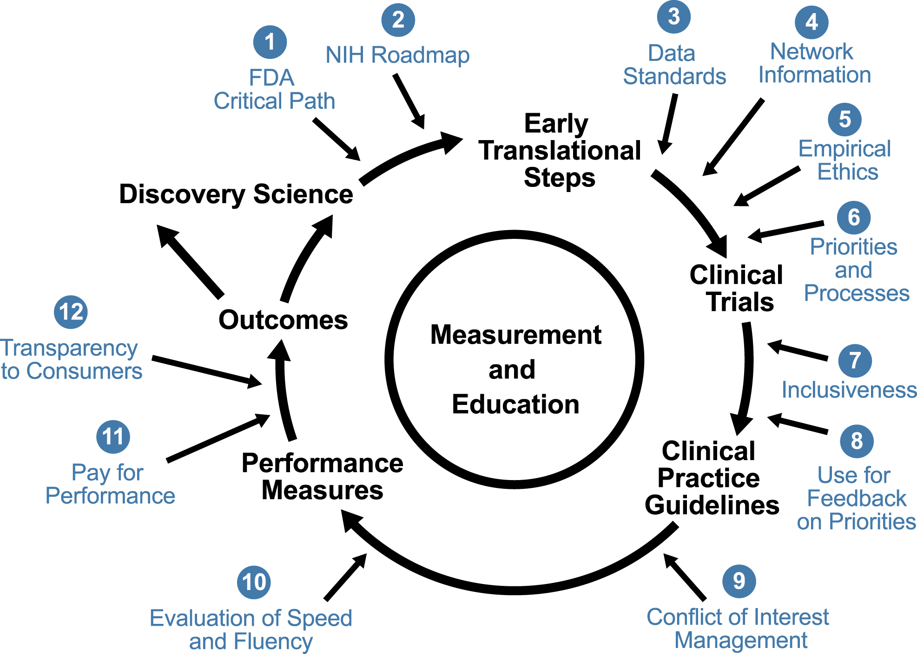
Generating Evidence to Inform Decisions

Slide 24
Our National Clinical Research System is Well-intentioned But Flawed
High percentage of decisions not supported by evidence*
Health outcomes and disparities are not improving
Current system is great except:
  Too slow, too expensive, and not reliable
  Doesn’t answer questions that matter most to patients
  Unattractive to clinicians & administrators
We are not generating the evidence we need to support the healthcare decisions that patients and their doctors have to make every day.
Source: Tricoci P et al. JAMA 2009;301:831-41

Slide 25
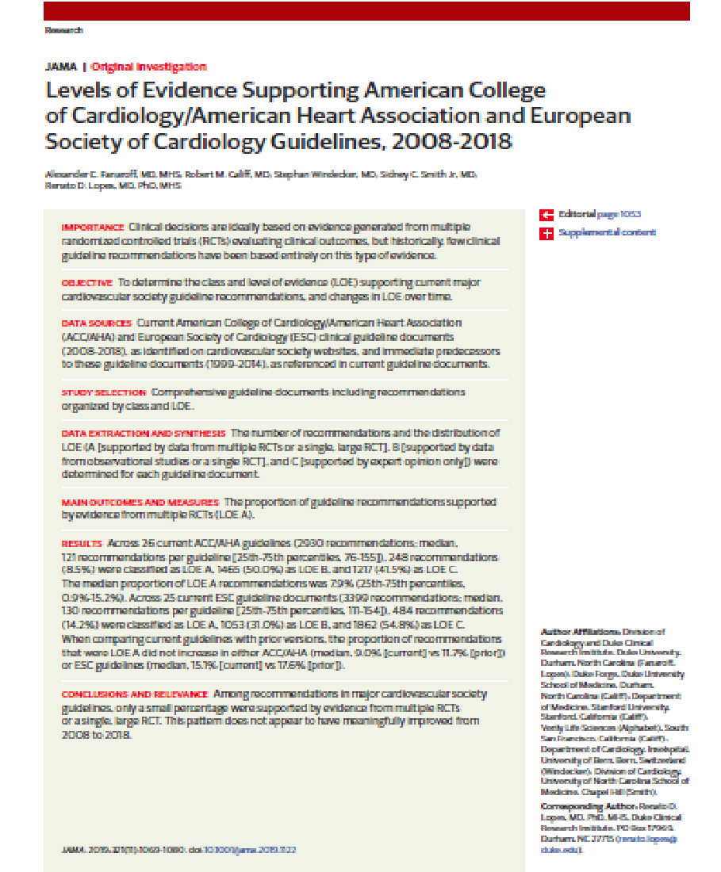
Across 26 current ACC/AHA guidelines, 8.5% of recommendations were LOE A
Across 25 ESC guidelines, 14.2% of recommendations were LOE A
This pattern does not appear to have meaningfully improved from 2008 to 2018
Source: Fanaroff AC, Lopes RD, et al. JAMA 2019;321:1069

Slide 26
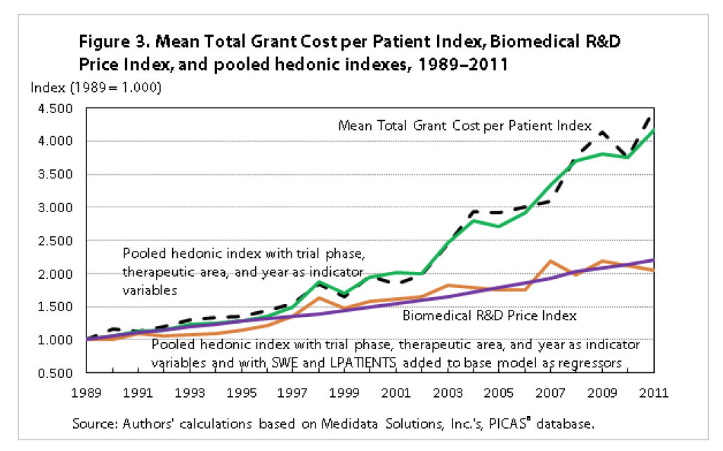
Trial Hyperinflation
Source: Berndt E, Cockburn I. Monthly Labor Review, June 2014

Slide 27
Societal Motivation
When possible, it is best to develop a concept, generate the evidence, implement strategies that are proven effective, and reassess for gaps and areas of improvement.

Slide 28
“Selfish Motivation”
The amount of heat generated about an FDA decision is inversely proportional to the quality of the evidence on the topic.

Slide 29
In God we trust, all others must bring high quality, reliable evidence
From Kurt Furberg, Circa 1990

Slide 30
Expert opinion is important and valuable. An expert with an opinion supported by reliable, high quality evidence is much more valuable.

Slide 31
Evidence to Practice
Clinical outcomes are improved most when interventions are planned and evaluated in a reasonable sequence.
Most interventions, despite good intentions, fail to provide benefits that exceed the risks.
For this reason, the law requires evidence that benefits outweigh risks for the intended use of the product.
The need for evidence generation continues for the life cycle of the product.

Slide 32
Generating Evidence to Inform Decisions

Slide 33
An Evidence Generation Infrastructure
Engaged participants and clinicians.
Outcome measurement and payment that aligns ecosystem with better participant/patient outcomes.
Inclusive communication tailored to the needs of diverse research participants.
Transparent, shared information across the ecosystem.
Quality by design to have the right amount of oversight/bureaucracy tuned to optimize useful research results.
Data quality and prospective design are critical.
Societal norms for data sharing and reciprocal obligations of data aggregators.

Slide 34
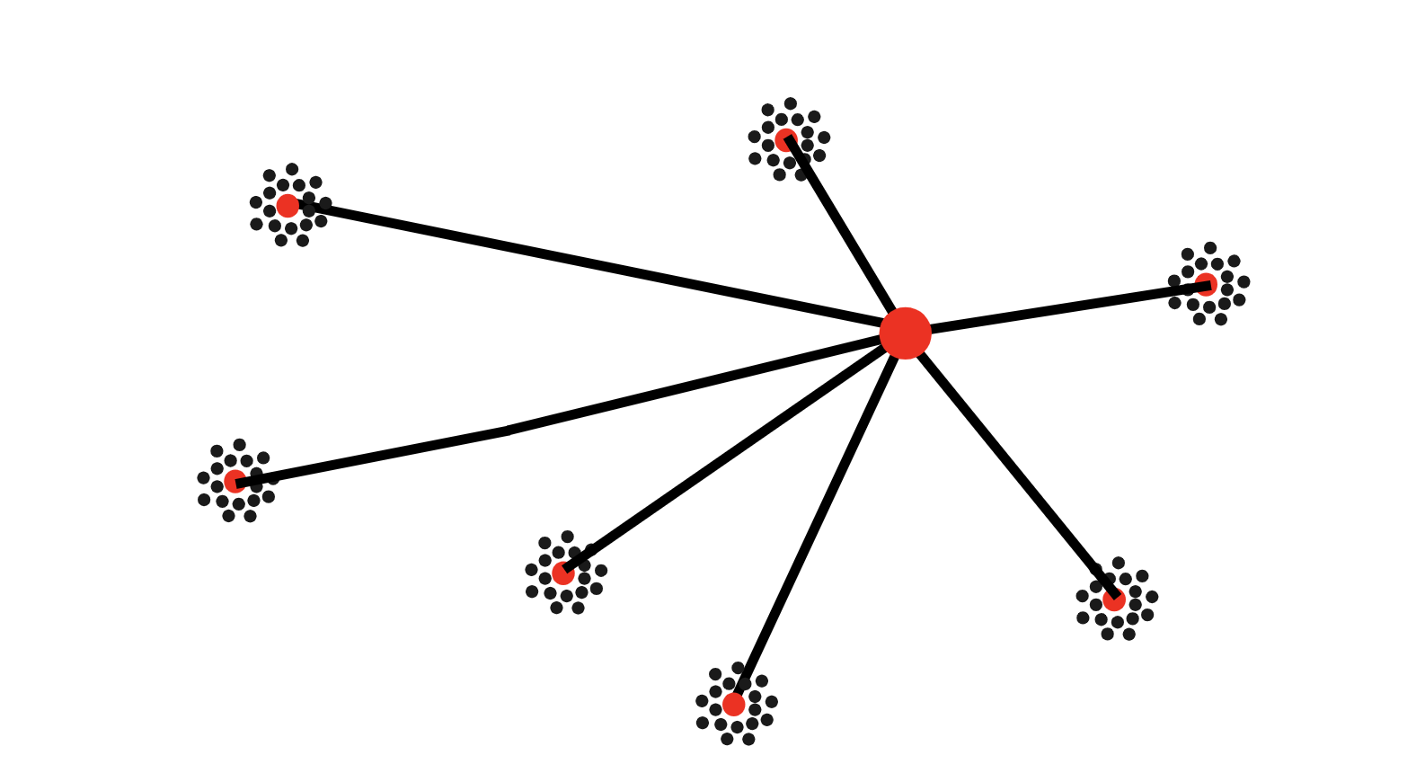
Typical NIH Network Academic Health Center Sites and Data Coordinating Center
Source: Stephen Strauss, NIH Roadmap 2004-2005

Slide 35
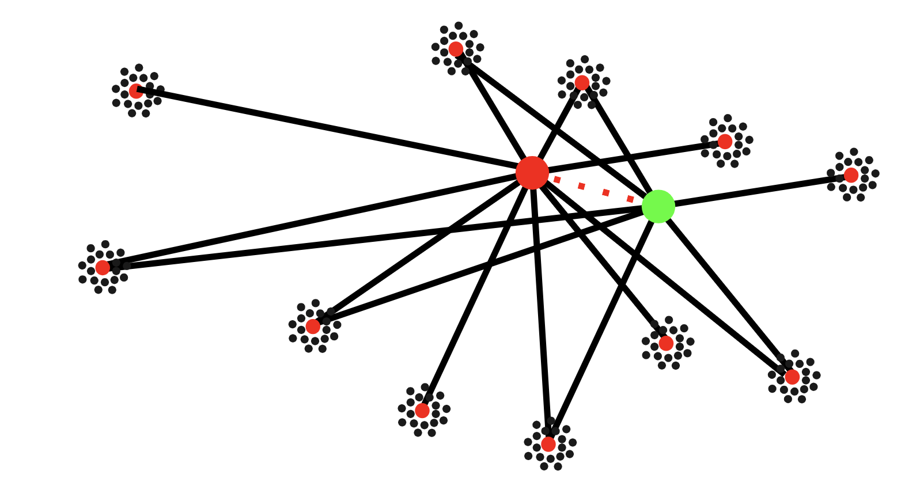
Networks Share Sites Interoperable and Data
Source: Stephen Strauss, NIH Roadmap 2004-2005

Slide 36
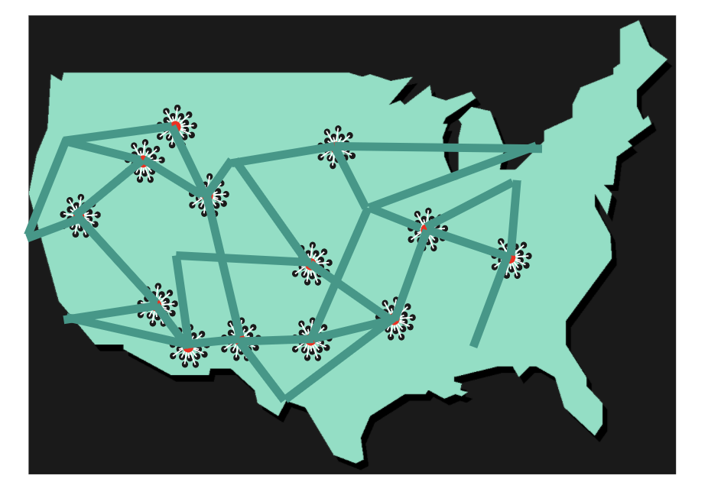
Integration of Clinical Research Networks
Link existing networks so clinical studies and trials can be conducted more effectively.
Ensure that patients, physicians, and scientists form true “Communities of Research.”
Stephen Strauss, NIH Roadmap 2004-2005

Slide 37
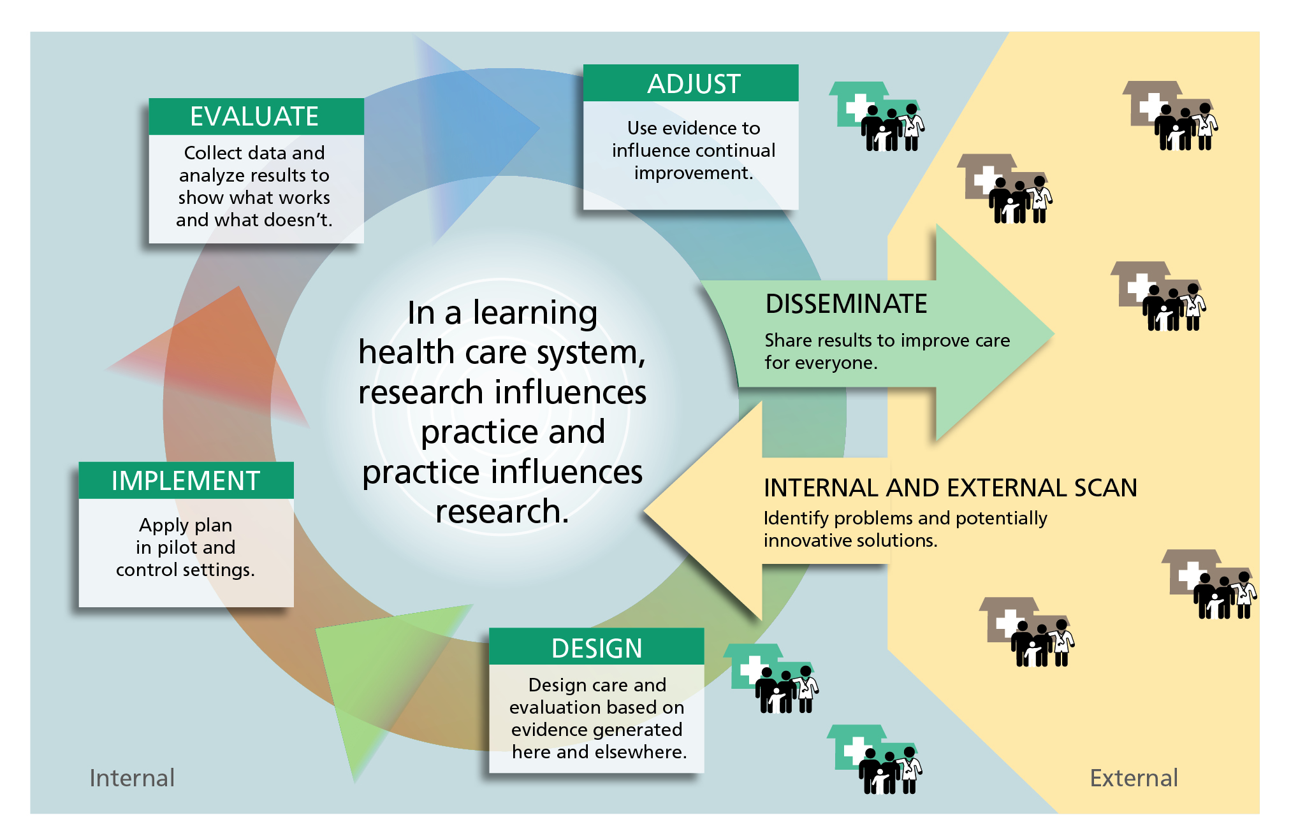
Learning Health Care Systems

Slide 38
National System Paradigm Shift
Current
Passive Surveillance
Challenging to find right pre/post market balance without confidence in post-market data
Parallel track to clinical practice
Inefficient one-off studies
National System
Active Surveillance to better protect patients
Leverage RWE to support regulatory decisions throughout TPLC
Embedded in Health Care System
(collect data during routine clinical care)
Shared system to inform the entire Ecosystem (patients, clinicians, providers, payers, FDA, Device Firms)

Slide 39
Learning Medical Device Ecosystem
Total Product Life Cycle (TPLC) Framework
INFORMATION FLOW
EVOLUTION OF BENEFIT–RISK EVIDENCE
Progressive
Approval, Safety and Performance
NEST
Expedited Access
Pathway
Real-World Evidence
Premarket
Review
National
Evaluation
System (NEST)
Premarket Decision
Patient Access
Postmarket
Surveillance
Benefit -Risk
Clinical Research Incorporated
Into Routine Clinical Practice
“Safety Net”
Benefit-Risk
TIME TO MARKET
INTERNATIONAL HARMONIZATION

Slide 40
SOUNDING BOARD
Transforming Evidence Generation to Support Health and Health Care Decisions
List of authors: Robert M. Califf, M.D., Melissa A. Robb, M.S.(Reg.Sci.), B.S.N.,
Andrew B. Bindman, M.D., Josephine P. Briggs, M.D., Francis S. Collins, M.D., Ph.D.,
Patrick H. Conway, M.D., Trinka S. Coster, M.D., Francesca E. Cunningham, Pharm.D.,
Nancy De Lew, M.A., Karen B. DeSalvo, M.D., M.P.H., Christine Dymek, Ed.D.,
Victor J. Dzau, M.D., et al.
December 15, 2016
N Engl J Med 2016; 375:2395-2400
DOI: 10.1056/NEJMsb1610128

Slide 42
Organize Operational Systems that Create Effective Research Networks Embedded in Practice and Bring them Together
Broad stakeholder participation in prospective RCTs
Regulatory approaches that facilitate practice-based systems for practice and research
Support for adequate time commitment by clinicians to engage with people/patients to ensure mutual understanding and appropriate informed consent
Efficient systems to handle contracting and liability
New paradigm for evidence generation in which clinical care and research are closely aligned

Slide 43
Establish Robust Frameworks for Autonomy, Privacy, Confidentiality and Security
A system in which patients and consumers are valued, integral participants in the development of evidence to inform care
Robust procedures to ensure data security and protect confidentiality
Efficient systems to keep patients and potential study participants informed about research opportunities and ensure appropriate informed consent
Balance of individual autonomy with public health needs

Slide 44
Adopt Common Approaches to Configuring, Storing and Reusing Digital Health Data with Appropriate Informed Consent and Privacy Protections
Interoperability among systems that capture, store and exchange health care data
Development of common standards and terminology for prospective data collection
Continuous effort to curate data to produce high-quality data sets fo ranalysis with the use of common data models
Streamlined randomized, controlled trials and high quality observational studies that leverage existing digital health and health care data to create efficiencies

Slide 45
Develop and Test New Methods to Reliably Answer Research Questions
Dissemination of information from pilot programs that provide proof of concept for efficient, scalable, randomized, controlled trials, cluster randomized trials and observational studies
Improvements in statistical and epidemiological methods to better leverage increasing amounts of existing health care data
Continued development of approaches to observational comparisons of treatments and empirical analysis of which methods are best for which types of research questions
Approaches that promote further integration of clinical care and research

Slide 46
Ensure Development of New Approaches that Facilitate Efficient Study Design and Conduct
Streamlined and harmonized processes that eliminate barriers to efficient research while ensuring needed safeguards
Systems for high quality and efficient ethics review and contracting
Development of approaches to assure the quality of research results that make better use of analytic approaches to increase efficiency

Slide 47
EvGen
All lanes are moving along well except for a few
  Prioritization of research questions
  Tower of Babel
  Quality by design
  Science and misinformation
  Front line clinicians
  Equity in research

Slide 48
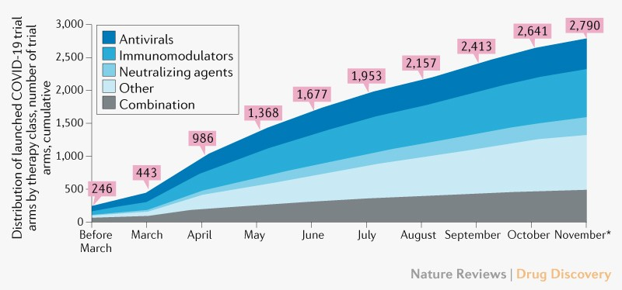
Source: Nature Reviews Drug Discovery

Slide 49
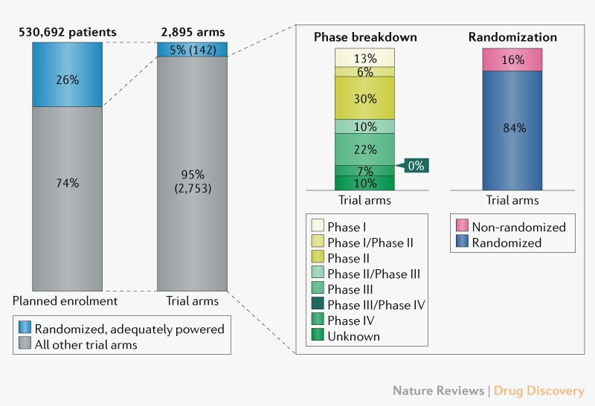
Source: Nature Reviews Drug Discovery

Slide 50
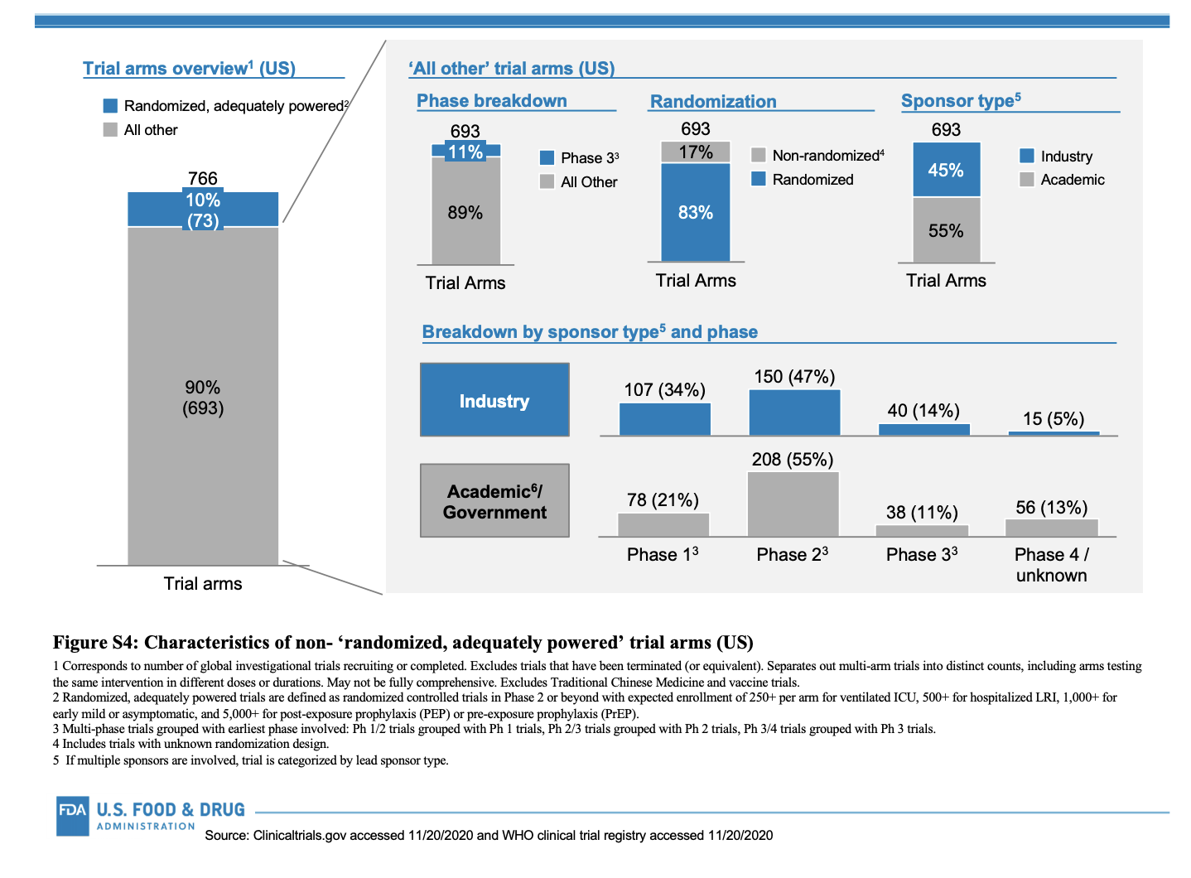

Slide 51
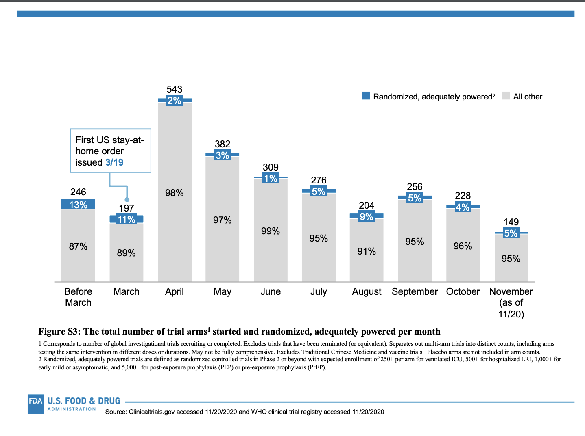

Slide 52
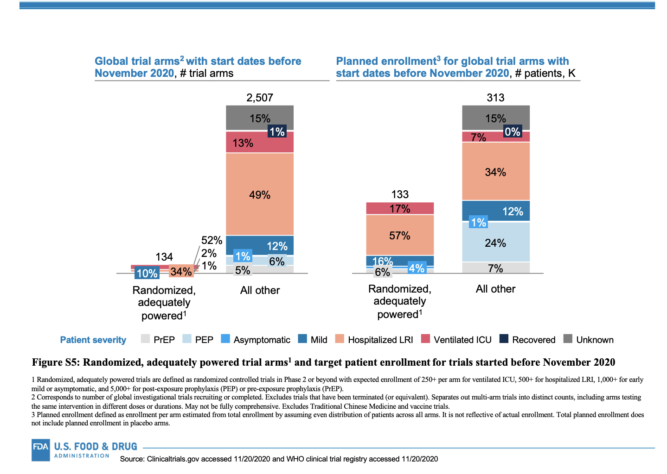

Slide 53
Genesis 11:1-9
They said to each other, “Come, let’s make bricks and bake them thoroughly.” They used brick instead of stone, and tar for mortar. ⁴ Then they said, “Come, let us build ourselves a city, with a tower that reaches to the heavens, so that we may make a name for ourselves; otherwise we will be scattered over the face of the whole earth.”
⁵ But the Lord came down to see the city and the tower the people were building. ⁶ The Lord said, “If as one people speaking the same language they have begun to do this, then nothing they plan to do will be impossible for them. ⁷ Come, let us go down and confuse their language so they will not understand each other.”
⁸ So the Lord scattered them from there over all the earth, and they stopped building the city. ⁹ That is why it was called Babel^{[c]}—because there the Lord confused the language of the whole world. From there the Lord scattered them over the face of the whole earth.

Slide 54

U.S. 21st Century Cures Act (2016)
Food & Drug Administration (FDA) shall establish a program to evaluate the potential use of real-world evidence (RWE) to:
  Support new indication for a drug approved under section 505(c)
  Satisfy post-approval study requirements
Draft framework to be issued by Dec 2018:
  Describe sources of RWD/RWE, challenges, pilot opportunities, etc.
Draft guidance for industry to be issued by Dec 2021
Standard for substantial evidence remains unchanged; commitments are aligned with Prescription Drug User Fee Act (PDUFA)

Slide 55
Ensure Development of New Approaches that Facilitate Efficient Study Design and Conduct
Streamlined and harmonized processes that eliminate barriers to efficient research while ensuring needed safeguards
Systems for high quality and efficient ethics review and contracting
Development of approaches to assure the quality of research results that make better use of analytic approaches to increase efficiency

Slide 56
‘Real-World’ Definitions (from FDA’s 2018 Framework)
Real World Data (RWD) are data relating to patient health status and/or delivery of health care routinely collected from a variety of sources
electronic health records (EHRs)
Real World Evidence (RWE) is clinical evidence regarding the usage and potential benefits/risks of a medical product derived from analysis of RWD
Generated using different study designs, including but not limited to randomized trials (e.g., large simple trials, pragmatic trials), externally controlled trials, or observational studies
medical claims data
product and disease registries
patient-generated data, including from
in-home settings
other sources that can inform on health status, such as “wearable” devices

Slide 57
Overview of Real-World Data and Study Design
Non-randomized/ interventional
Non-randomized/ non-interventional
Randomized/interventional
Traditional randomized trial,
using elements of RWD
Trials in clinical practice settings
(“with pragmatic elements”)
Externally controlled trial
Observational study
RWD to support site selection
RCT using electronic case report forms or EHR or claims data, etc.
Single-arm trial with RWD external control arm
Observational cohort study
RWD to assess enrollment criteria & trial feasibility
Selected outcomes identified using EHR or claims data, data from digital health technologies, etc.
Case-control study
Increasing reliance on RWD
Office of Med Policy Aug 2021

Slide 58
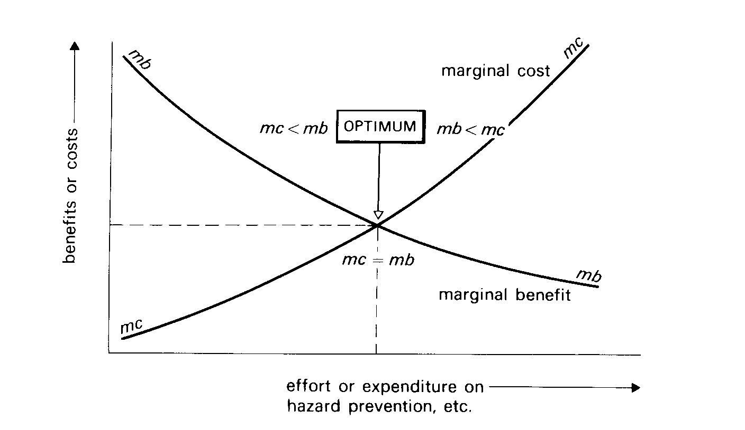
Key Quality Considerations:
FDA and EMA
Simply advocating the “highest level” of quality has little practical meaning in itself.
The cost associated with incremental improvements in quality becomes ever higher as perfection is approached and becomes disproportionate to any additional benefit achieved.

Slide 59
Building Quality into Clinical Trials
Quality cannot be monitored, audited, or inspected in retrospectively
“The most important tool for ensuring human subject protection and high-quality data is a well-designed and articulated protocol.”
FDA Risk-based Monitoring Guidance (published August 2013)
At the trial level, the protocol – or more appropriately the investigational plan -- is the blueprint for quality

Slide 60
Key Considerations: Complexity
24.7% of procedures performed per phase-III protocol and 17.7% of all phase-II procedures per protocol were classified as "Noncore" in that they supported supplemental secondary, tertiary, and exploratory end points.
The total direct cost to perform Noncore procedures is conservatively estimated at $3.7 billion annually, not including the indirect costs associated with collecting and managing these data and the ethical costs of exposing study volunteers to unnecessary risks associated with conducting extraneous procedures.
Quantifying the Magnitude and Cost of Collecting Extraneous Protocol Data KA Getz et al. Am J Ther 22 (2), 117-124. Mar-Apr 2015. more
ICH E6 R2: The sponsor should ensure that all aspects of the trial are operationally feasible and should avoid unnecessary complexity, procedures, and data collection.

Slide 61
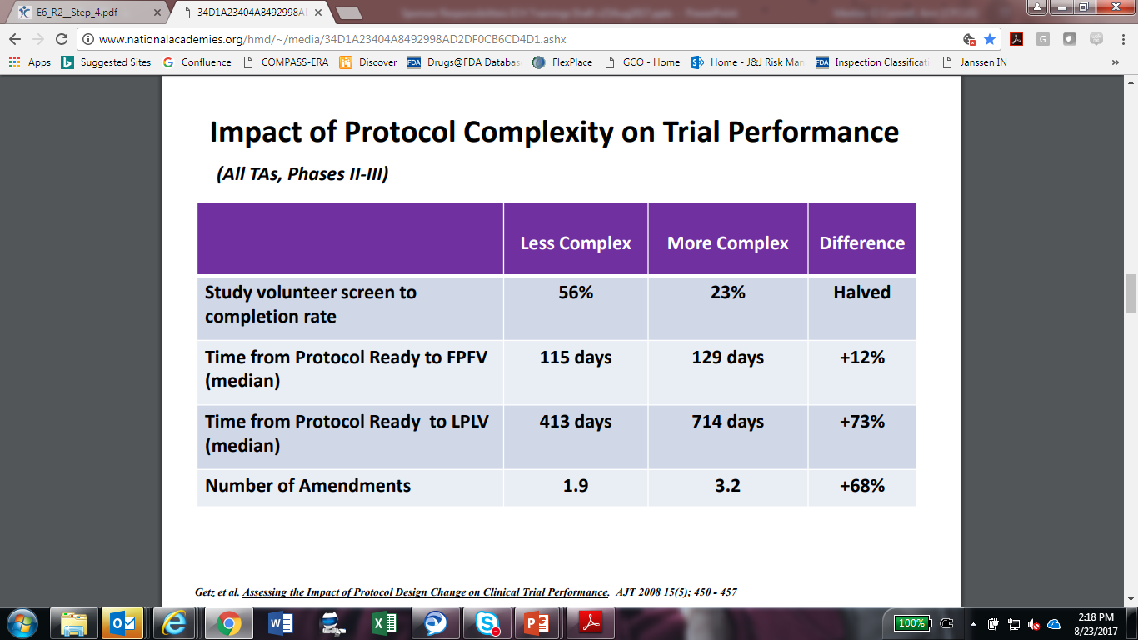

Slide 62
Re-Framing Quality
    “Quality” is the absence of errors that
    matter to decision-making
    i.e. errors that have a meaningful impact
    on the safety of trial participants
    or credibility of the results
    (and thereby the care of future patients and consumer)

Slide 64
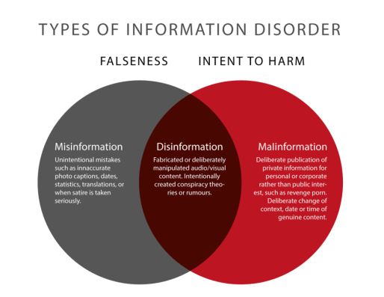
Varying forms of misinformation carry different levels of threat
“Disinformation,” is intended to mislead and is disseminated with knowledge that those who succumb to it could be harmed
“Malinformation” is which represents a purposeful effort to harm others directly by spreading incorrect information.
https://flowersforsocrates.com/2018/08/12/disinformation-misinformation-malinformation-involves-framing/

Slide 65


Slide 66
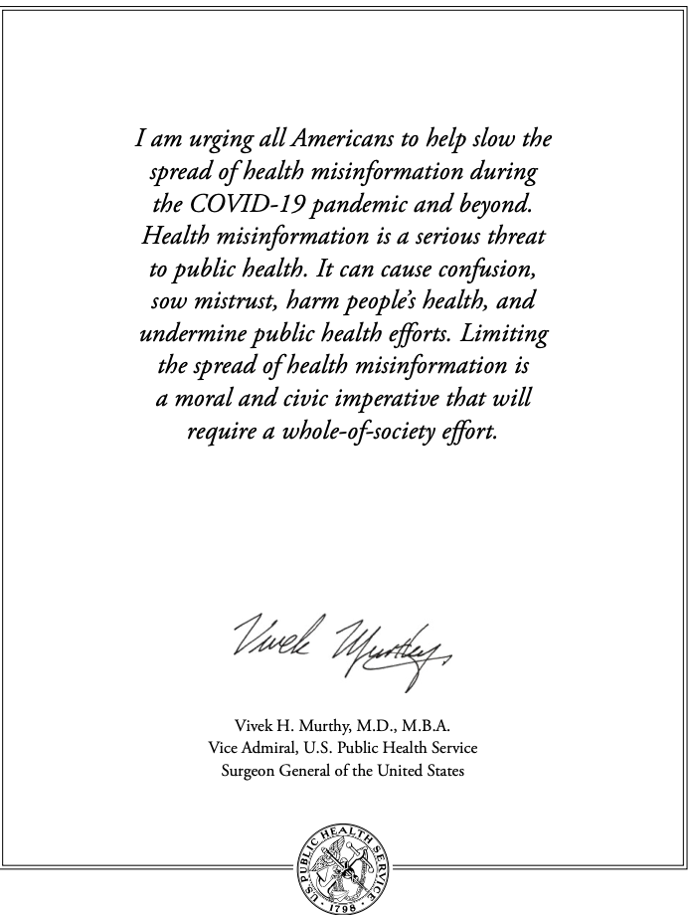

Slide 67
Misinformation
Call attention to the problem
Elevate and repeat reliable, truthful information
Identify disinformation and actively oppose/remove it
Welcome debate in the vast middle ground of legitimate opinions
Activate societal institutions that are currently passive
  Universities and academic medical centers
  Community college systems
  Health systems
  Professional societies

Slide 68
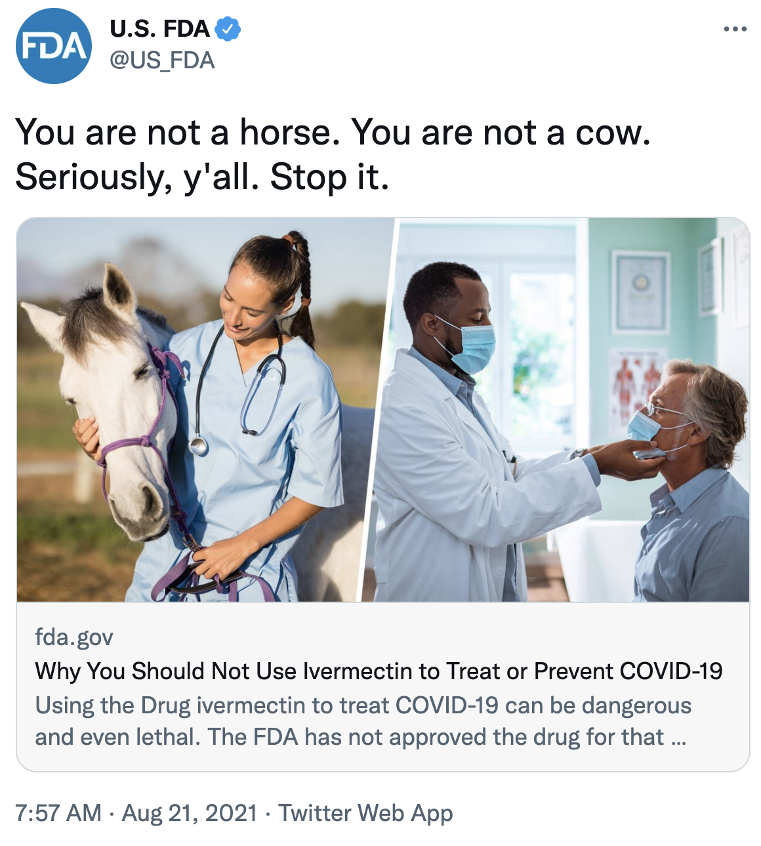

Slide 69
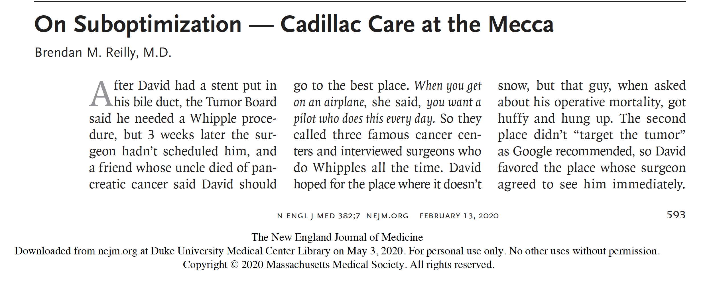

Slide 70
A consequence of failure to integrate is suboptimization: Suboptimization is a term that has been adopted for a common policy mistake.
It refers to the practice of focusing on one component of a total and making changes intended to improve that one component and ignoring the effects on the other components.

Slide 71
Patients and their families are at the center. And most patients with a disease highly value a happy, trusted clinician(s) & team.
Patients
&
Families
Clinicians

Slide 72
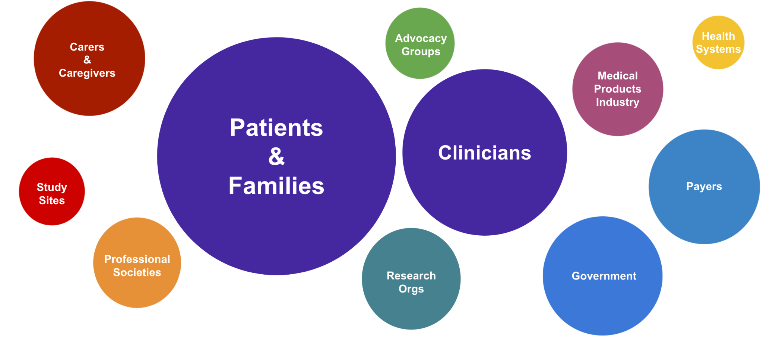
The reality is we have is a disaggregated, fragmented system with lack of organization around common, transparent high-quality information

Slide 73
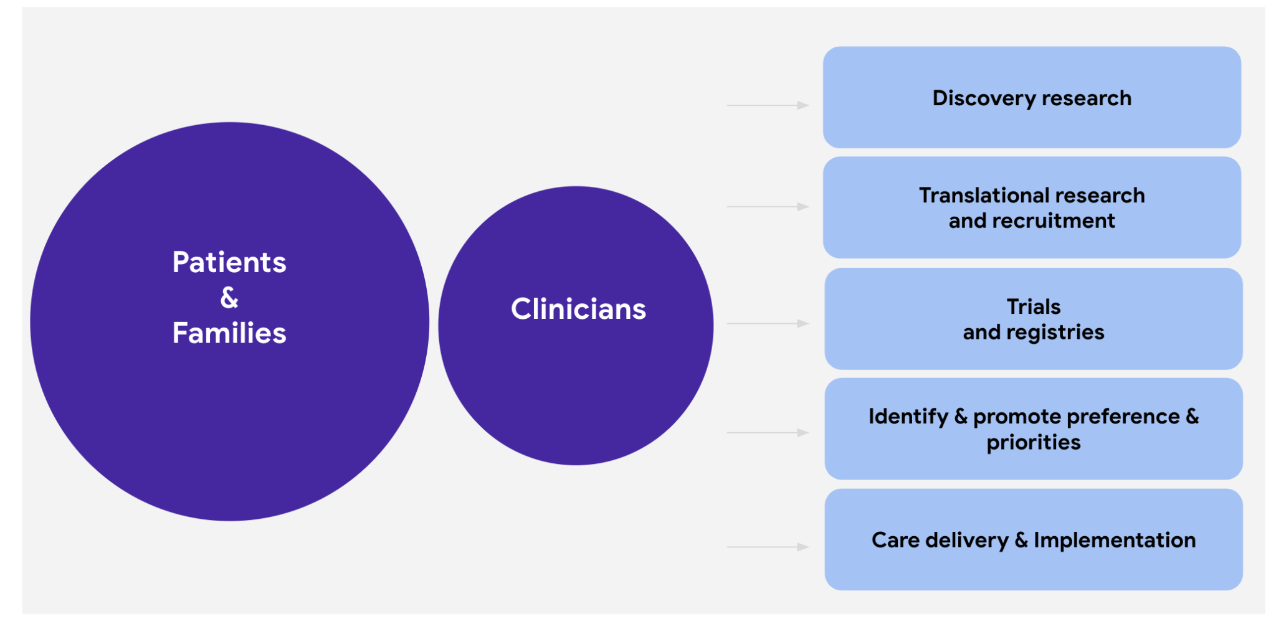
If patients and clinicians banded together to optimize the information base for high-quality, evidence-based care…

Slide 74
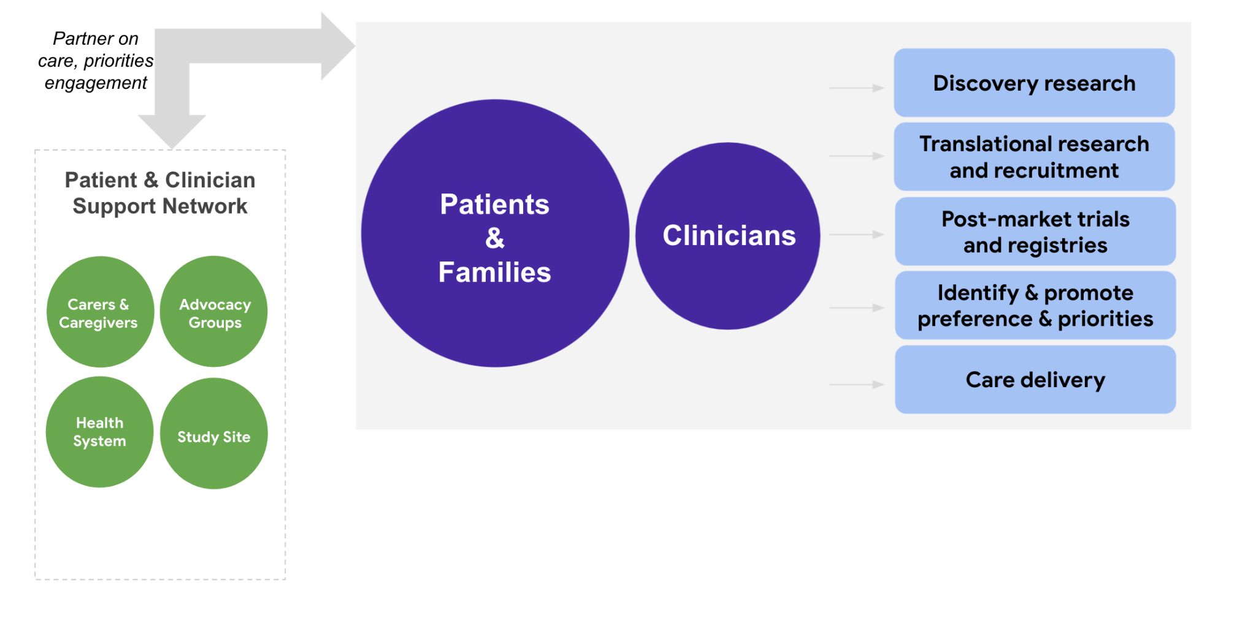
Organizations that support the patient-clinician dyad would do better with common goals

Slide 75
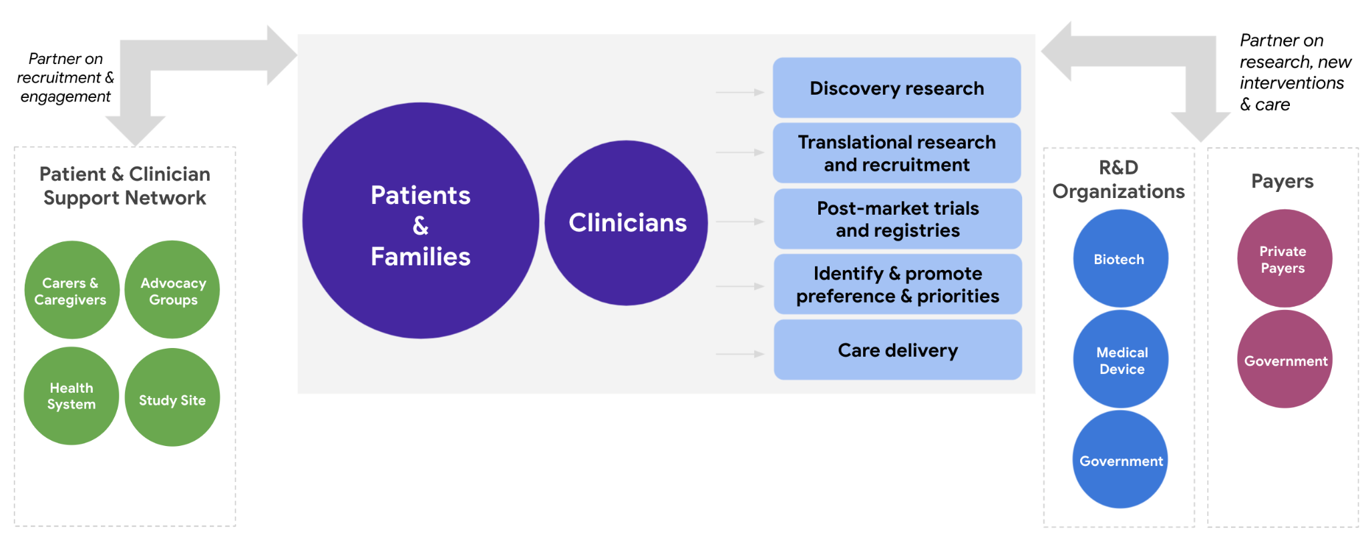
The medical products industry & payers would benefit from higher quality information and participation

Slide 76
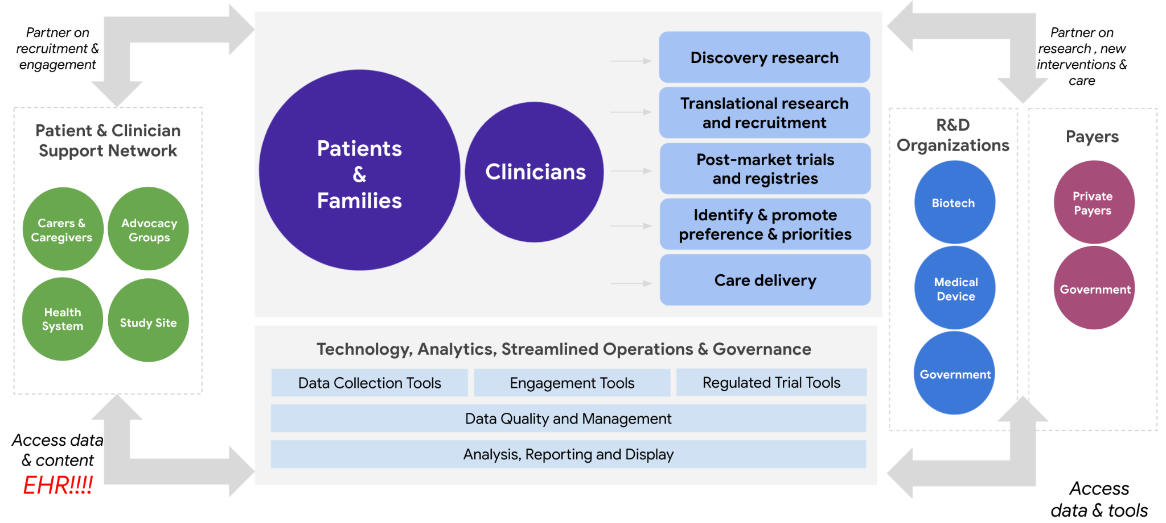
Given common goals, current technology could support a common information base that could support the primary mission: better outcomes for patients

Slide 77
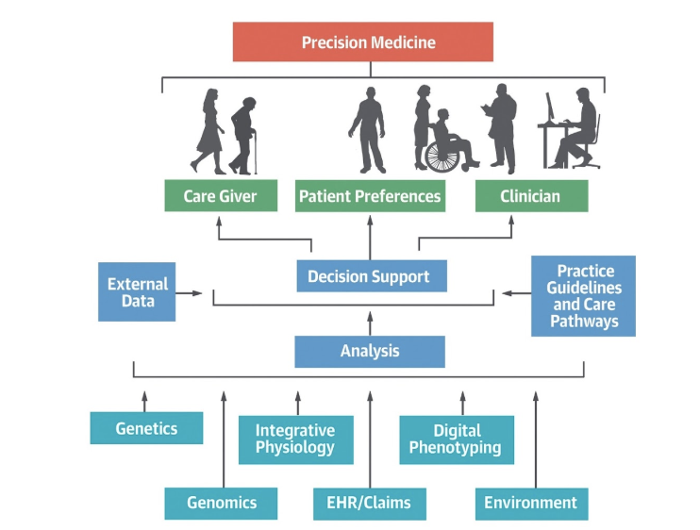
Central Illustration: Precision Medicine
Califf, R.M. J Am Coll Cardiology. 2018;72(25):3301-9

Slide 78
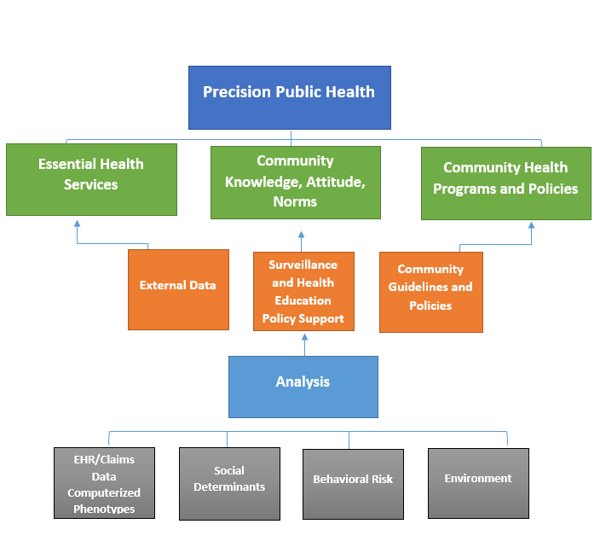
Central Illustration: Precision Public Health
JACC: Volume 76, Issue 3, 21 July 2020, Pages 306-320

Slide 79
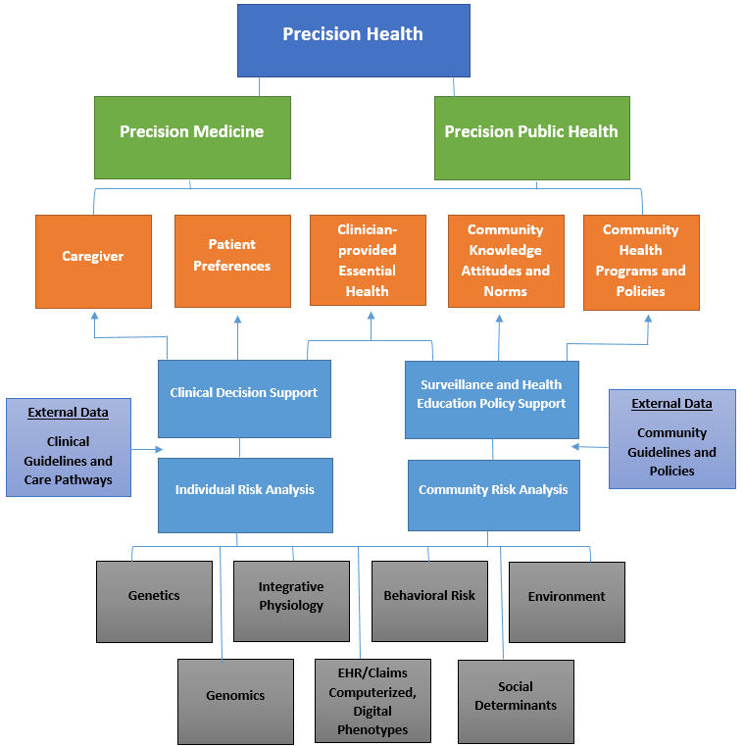
Data-driven Merger of Precision Medicine & Precision Public Health
JACC: Volume 76, Issue 3, 21 July 2020, Pages 306-320

Slide 80
The Opportunity
Biomedical science and technology are in an amazing period of discovery and development.
Yet these advantages are not resulting in superior health and outcomes for the U.S. population or for most individuals.
The intersection of biomedical science, technology and communication, if handled with good policies, investment and communication, could usher in a new era of better health for the U.S. and the world.
Previous policies and infrastructure investment provide a solid base from which to build an effective system for evaluation and implementation across the spectrum of development, pivotal trials and post-market evaluation.

